Slide 1
Pine Savannas
Tropical Ecology of Belize
Bio-270 J-term 2015
Maegan Majka and Christiana Bredbenner

Slide 2
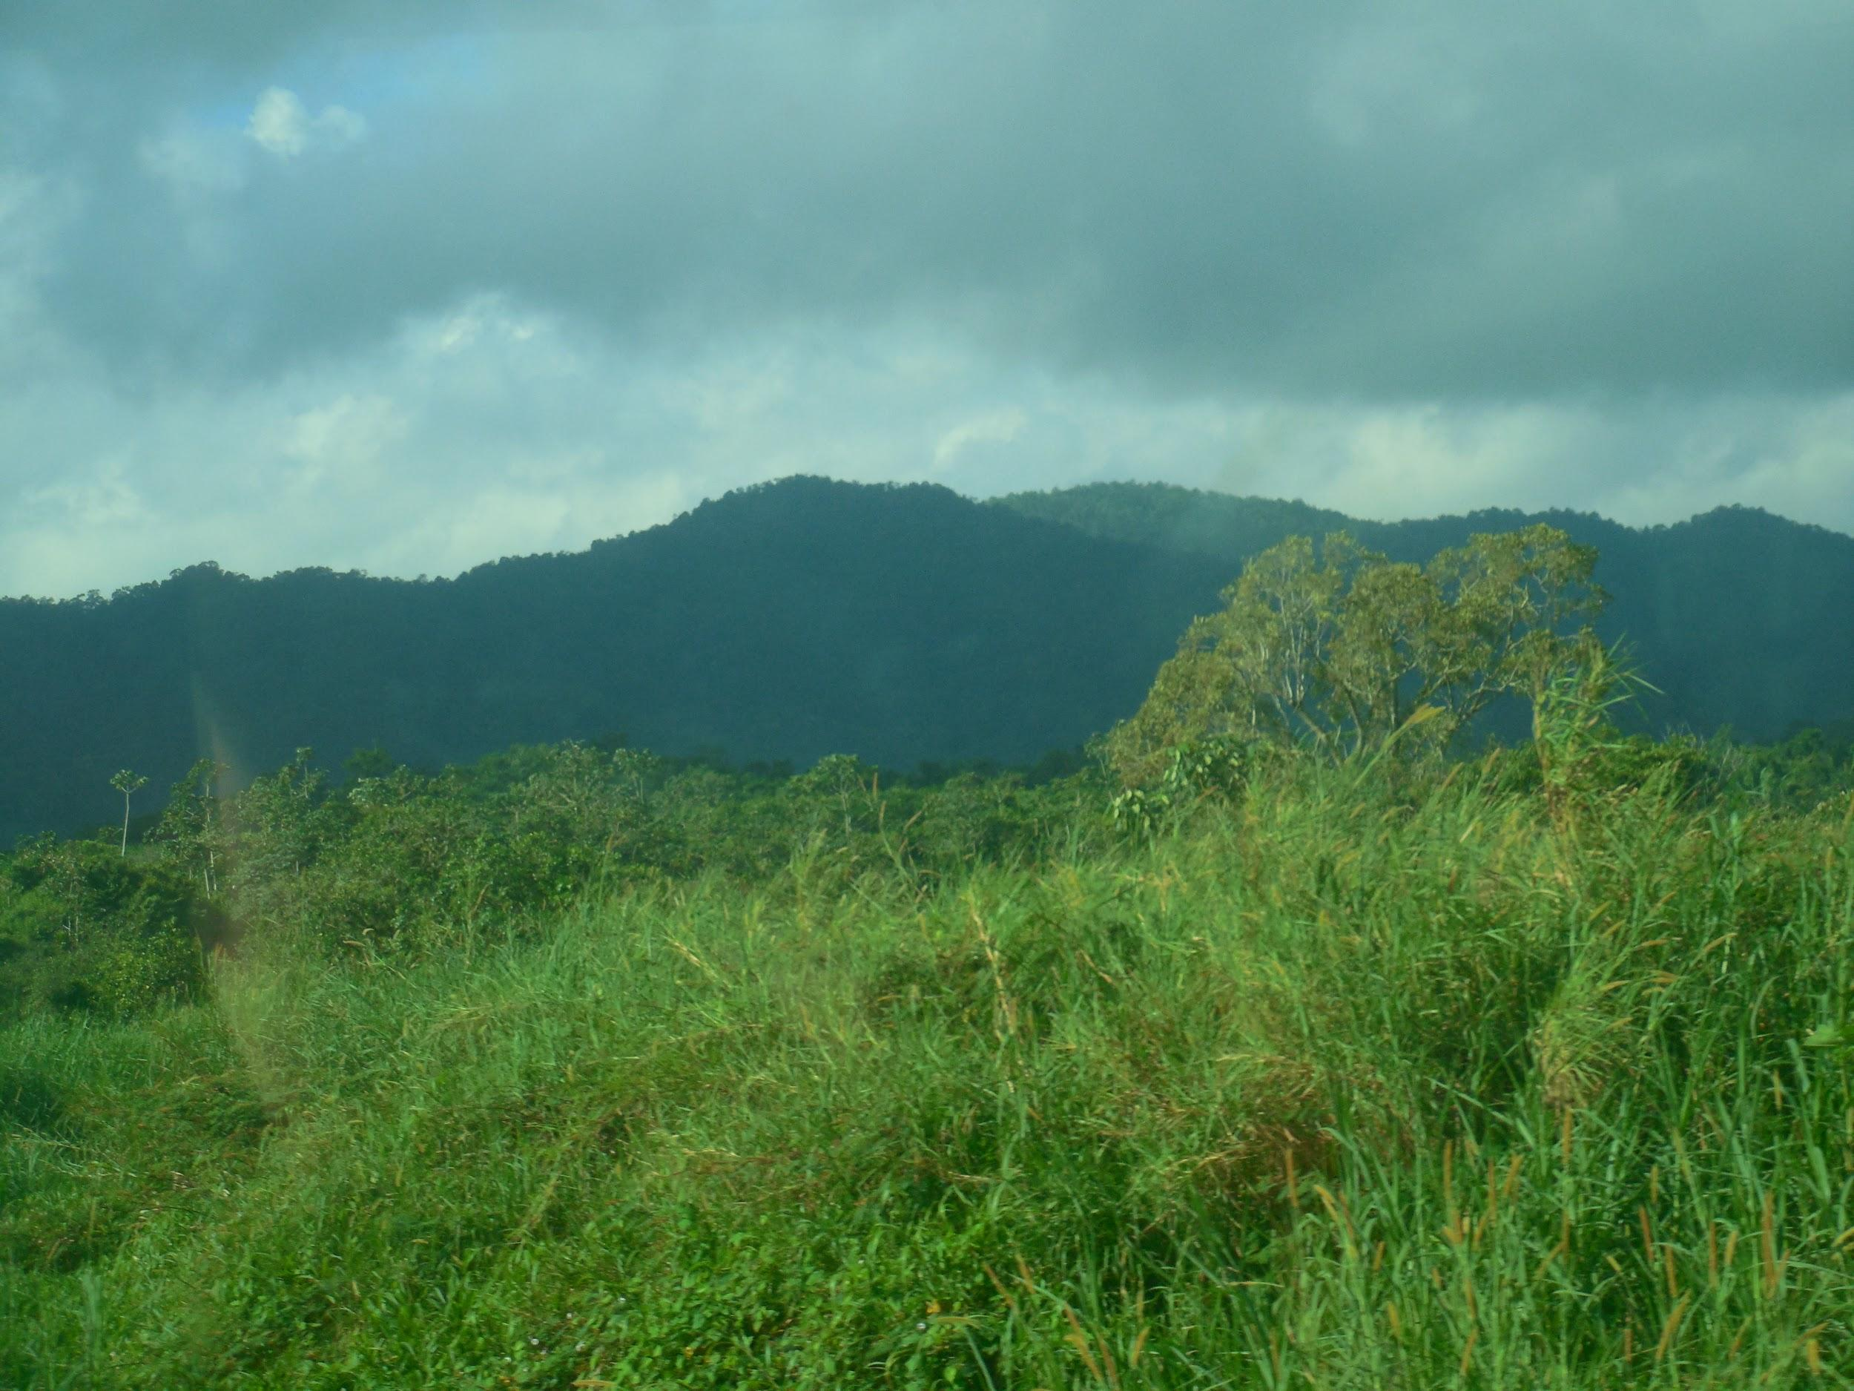
Pine Savanna
Four defining characteristics
Either complete or almost complete ground cover of a grassy area with trees and shrubs, with full canopy or open grassland
Annual fires in the dry season
Nutrient- poor soil
Topographic variety

Slide 3
Upland Savannas
Occurs where soil is nutrient poor
Drains rapidly due to slopes
Fire and powerful storms hinder woody vegetation growth
Savannas prevail where forests cannot grow
Coarse soil texture
Poor seasonal drainage

Slide 4
Upland Savannas Ctd.
Under-represented in national protection
Little information on condition of pine savanna
Most recent map is inadequate
Few details for economic use or conservation

Slide 5
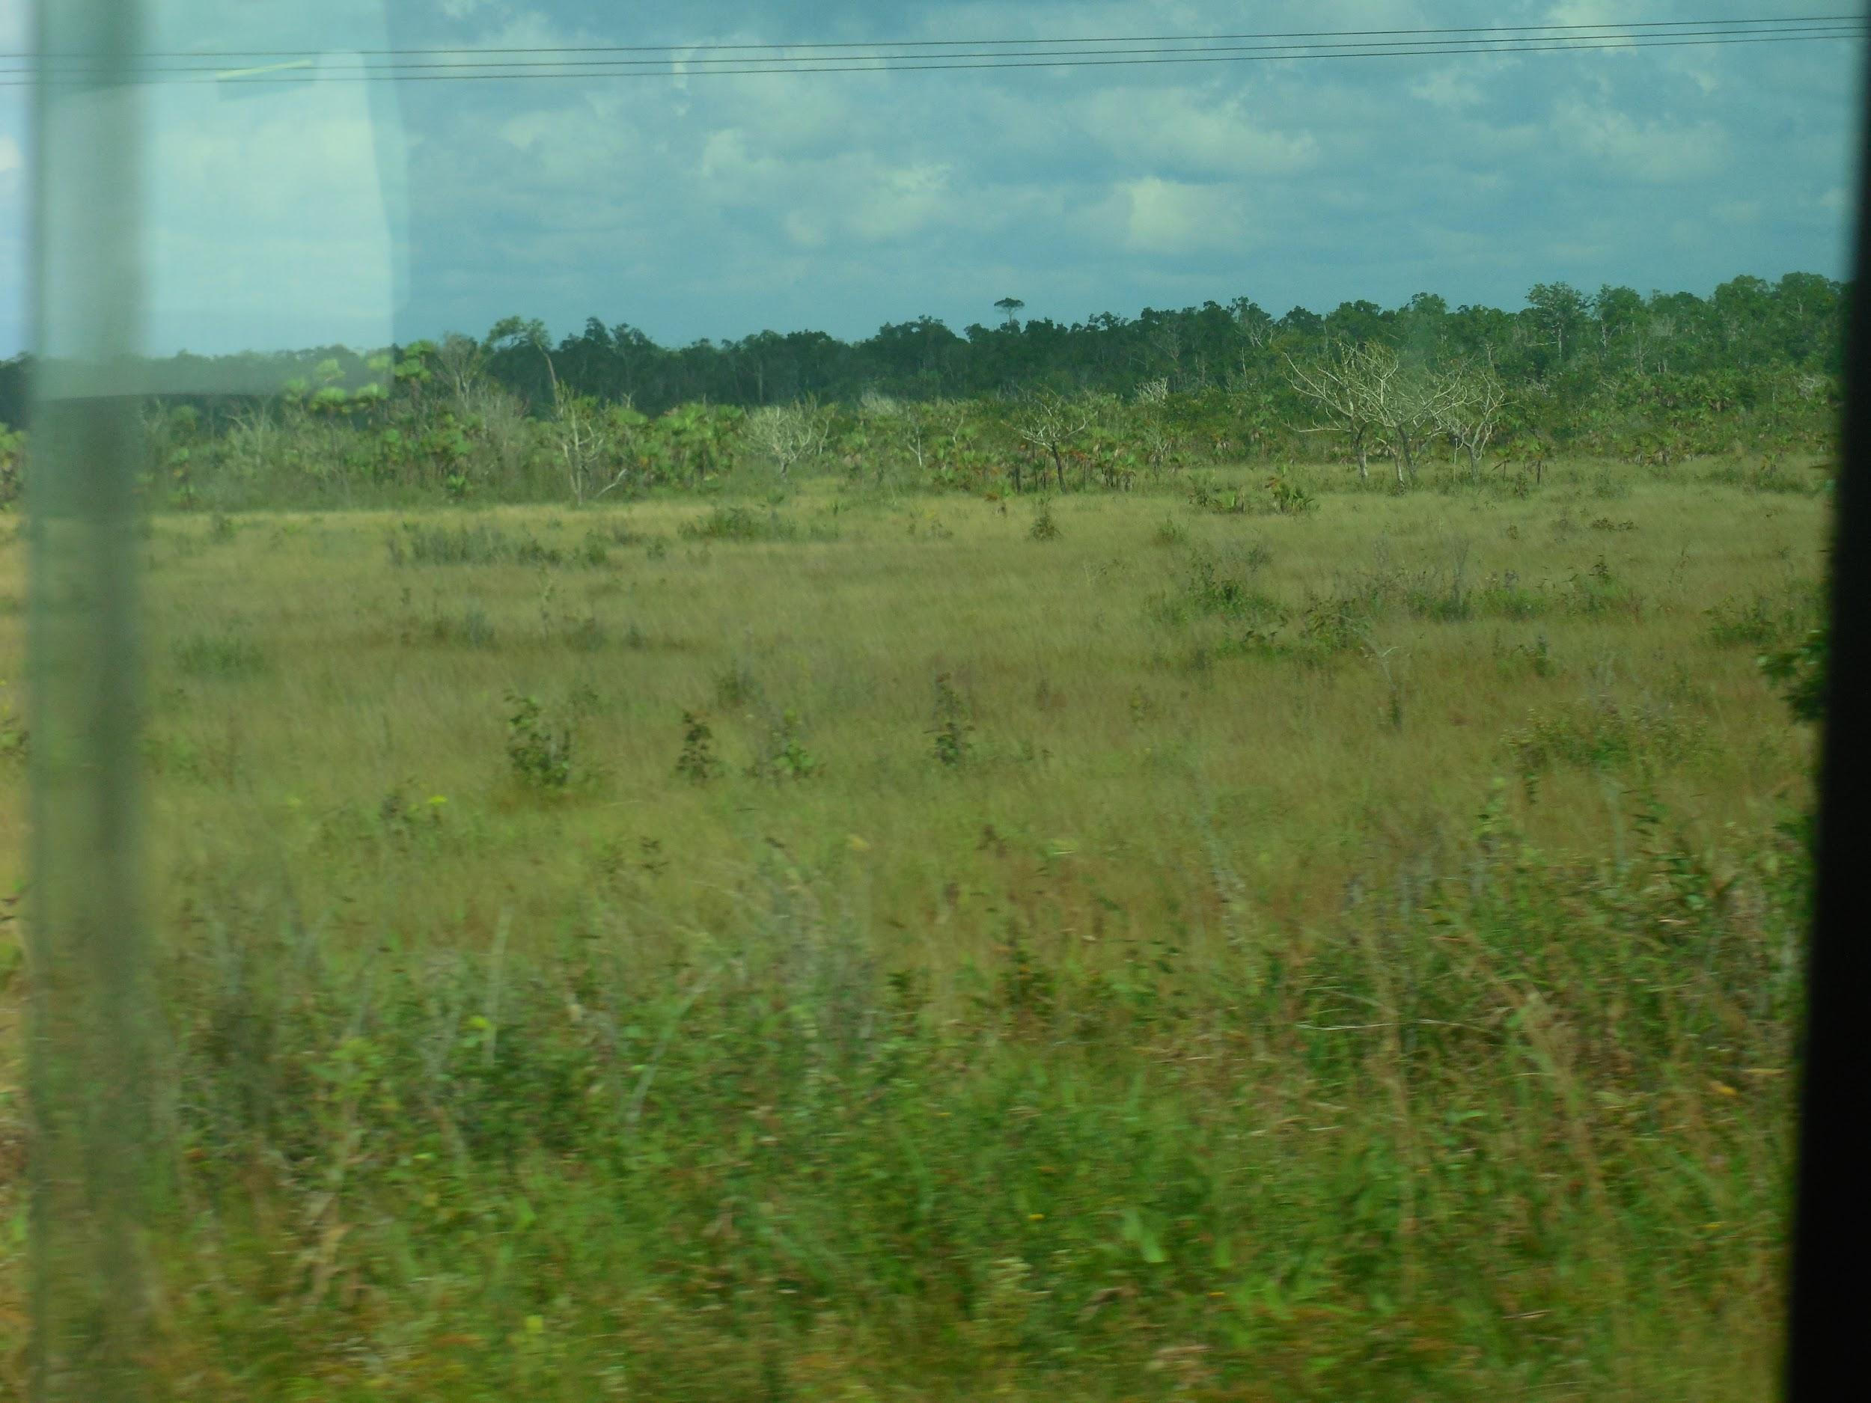
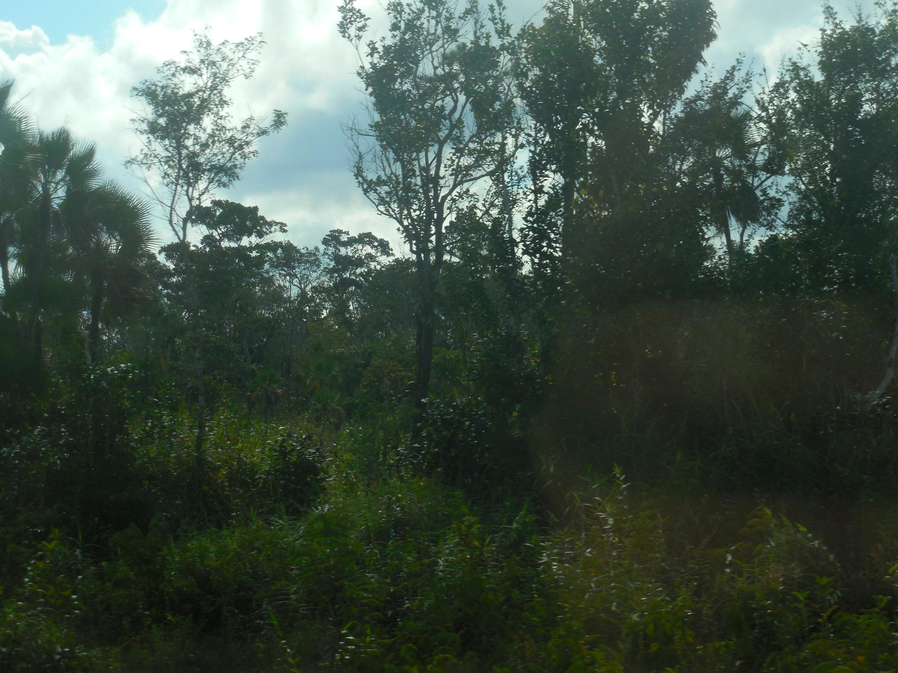
3 distinct types of savanna
Open Savanna
Mostly grass with few trees
Less than 10% canopy cover
Dense Tree Savanna
Primarily pine and oak tree’s
10-50% canopy cover
Underlayer of grass

Slide 6
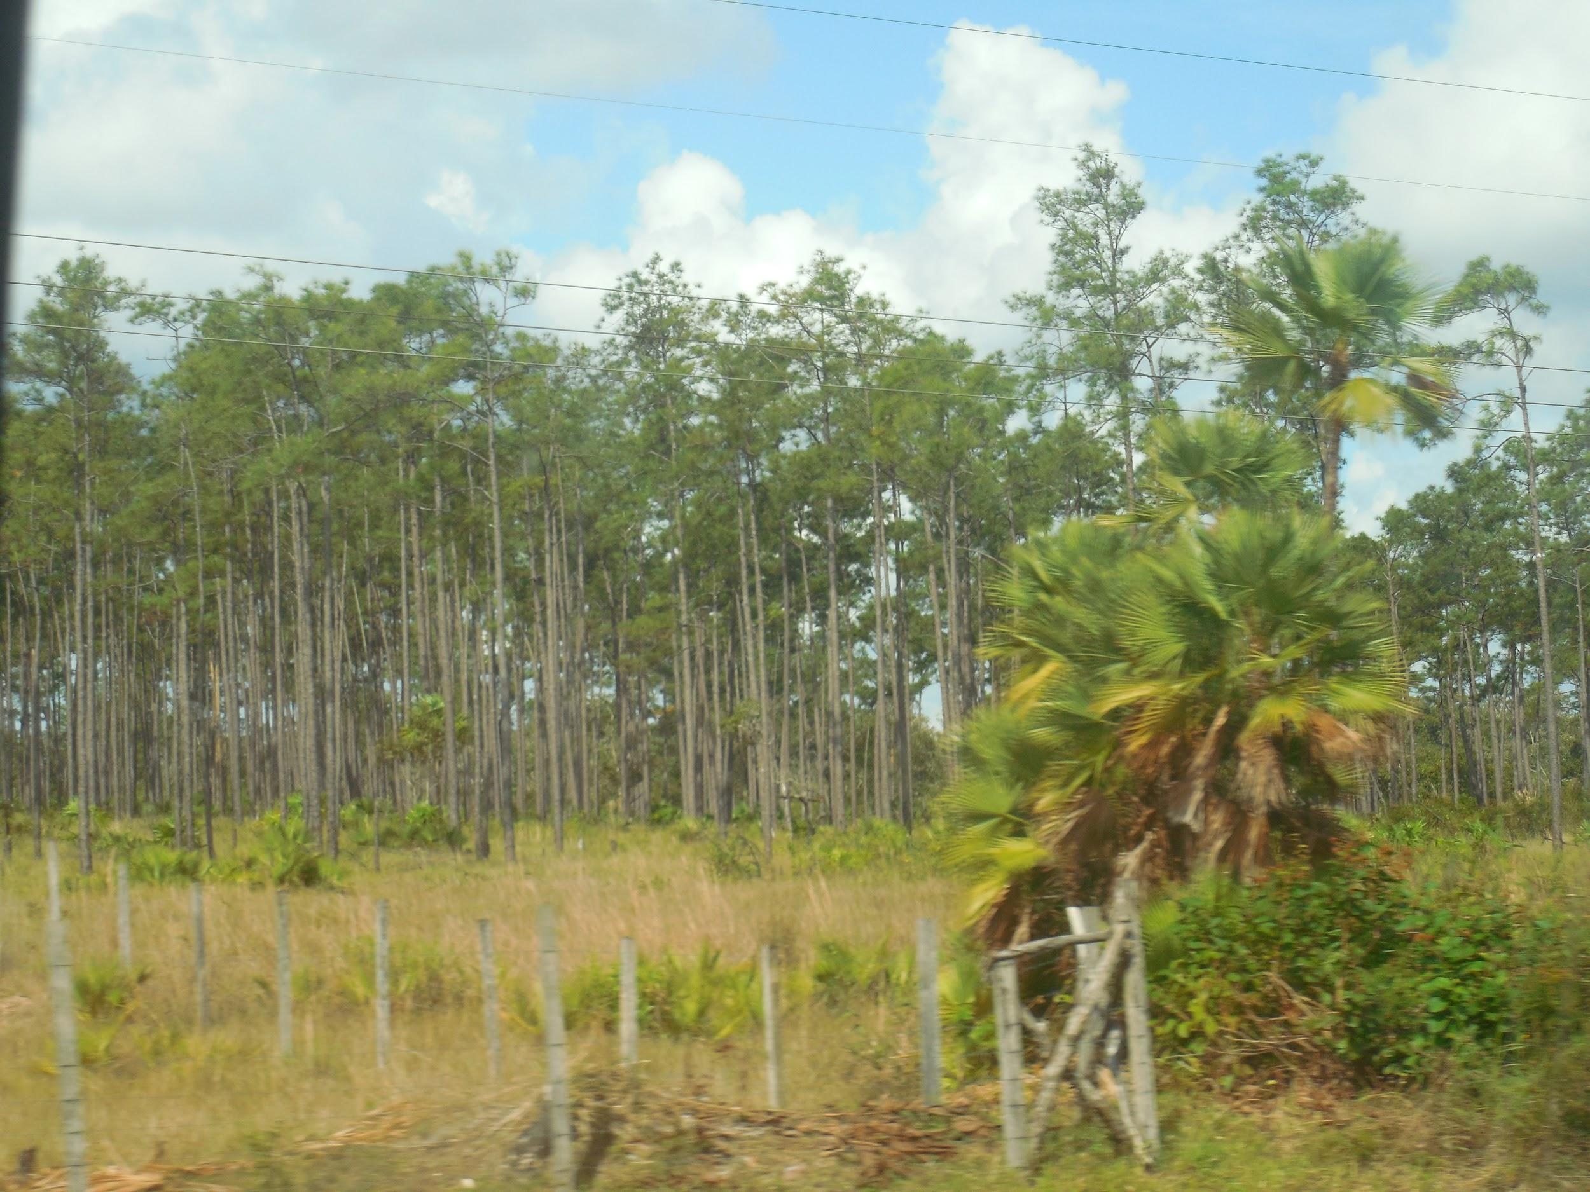
Savanna Types Ctd.
Seasonally waterlogged Savanna
Evenly spaced shrubs or trees
Greater amount of woody shrubbery and trees
Acts as transition between wetlands and savanna
Sedge prevails
Rarest type of savanna
Dense Tree Savanna

Slide 7
Fire Ecology
Fire resistant trees- Pine, Calabash, Craboo, Palmetto
Fire can start because of embers, lightening, or glass bottles
* glass bottles act as a magnifying glass
Savanna can take 2-3 years to fully recover
Fire kills competing plants
Plants grow back more quickly after a fire

Slide 8
Activities in the Vicinity of T.E.C
Baboon Sanctuary
Geraldine and the howler monkeys
*She fed them but warned us not to pet them
* “They are not dumb animals, they aren’t pets.”

Slide 9
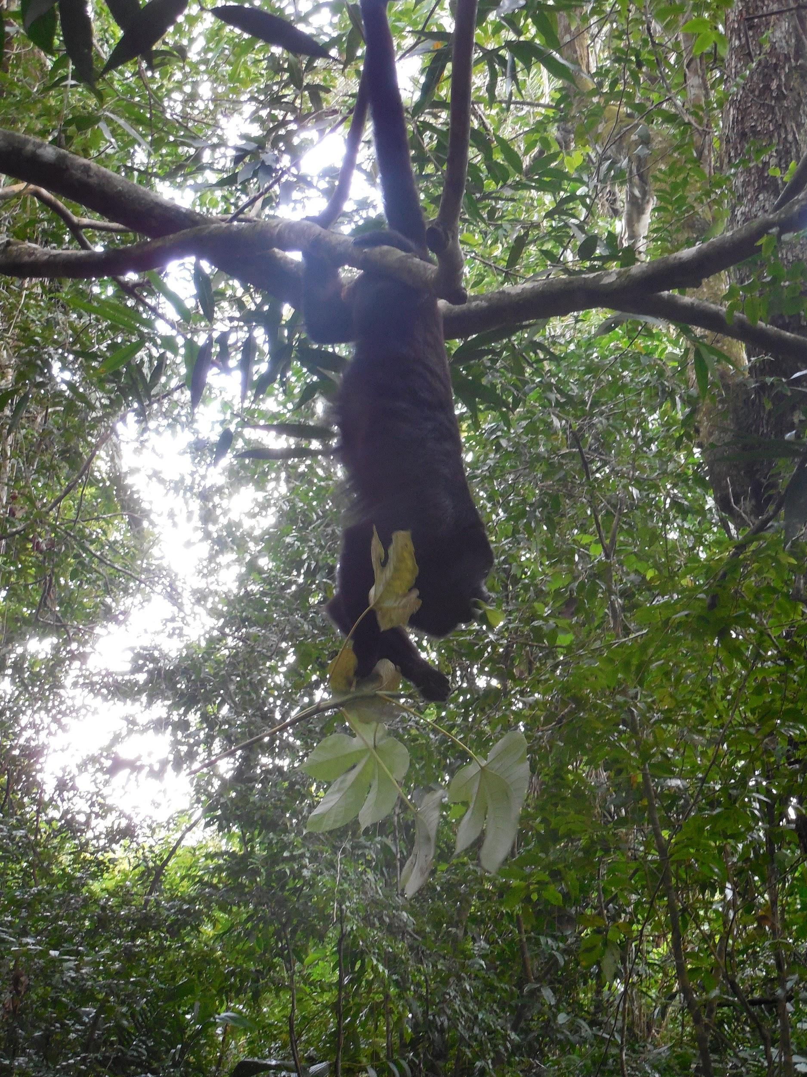
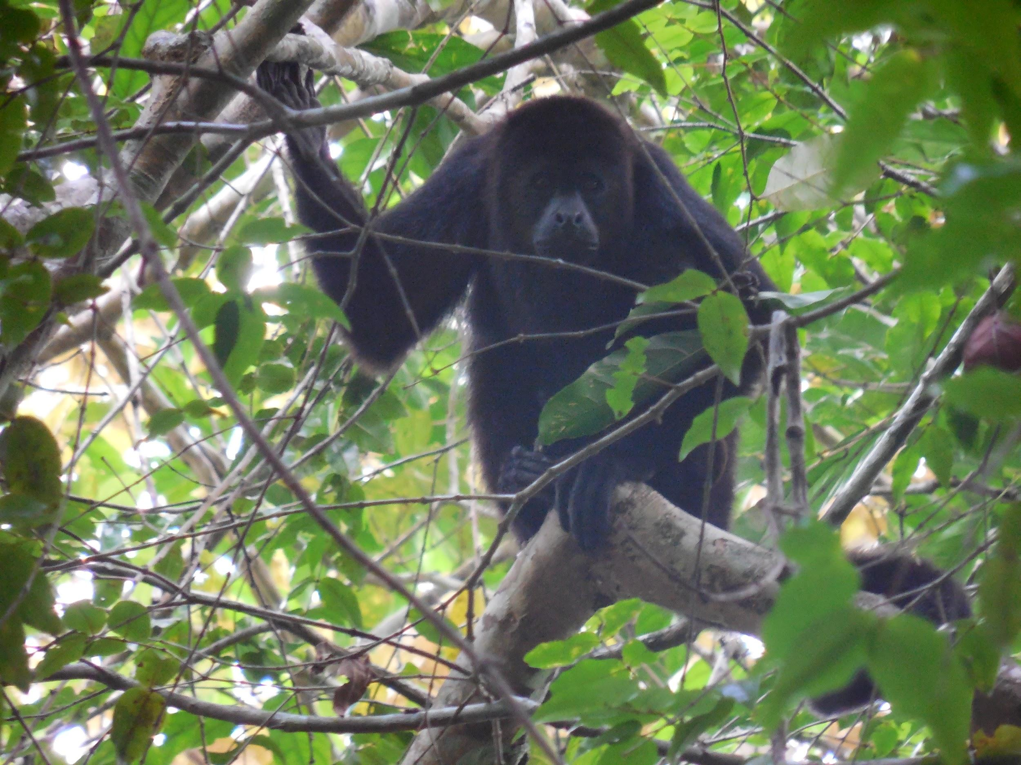
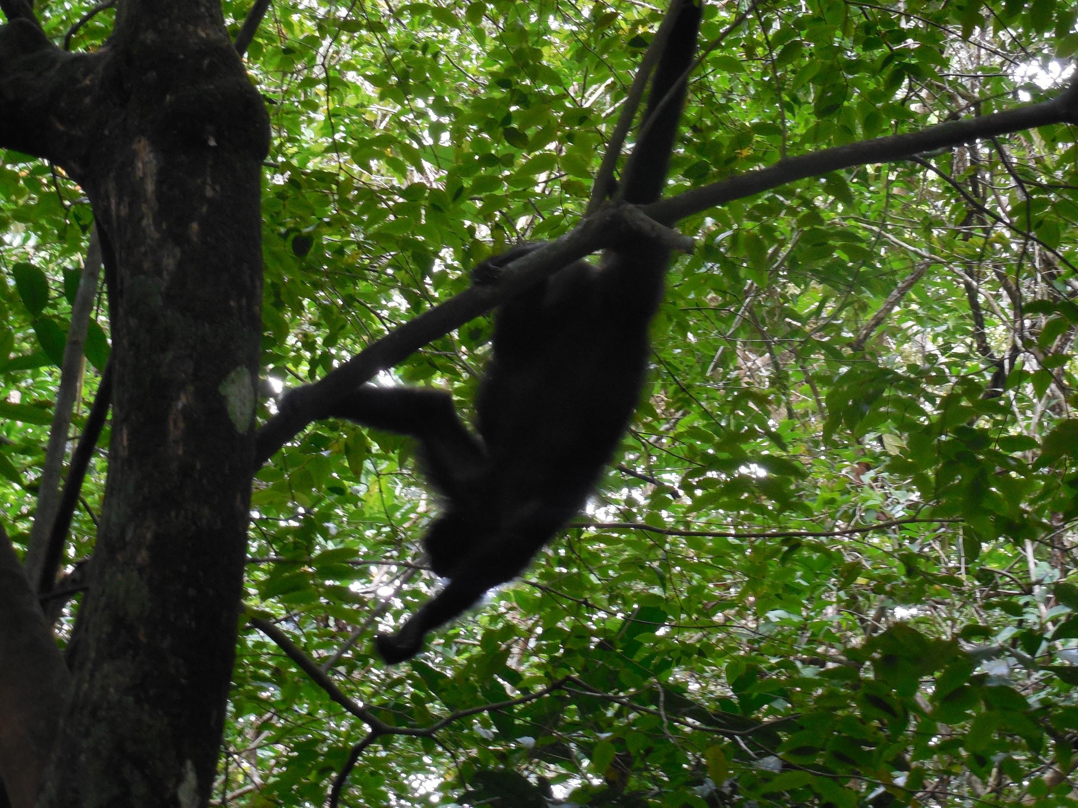
The Baboon Sanctuary

Slide 10
The Baboon Sanctuary
Farmers do not fight for removal of the monkeys
* Monkeys do not bother the crops
* Farmers can grow shade tolerant crops under canopy
Helps with conservation of the monkeys and their habitat

Slide 11
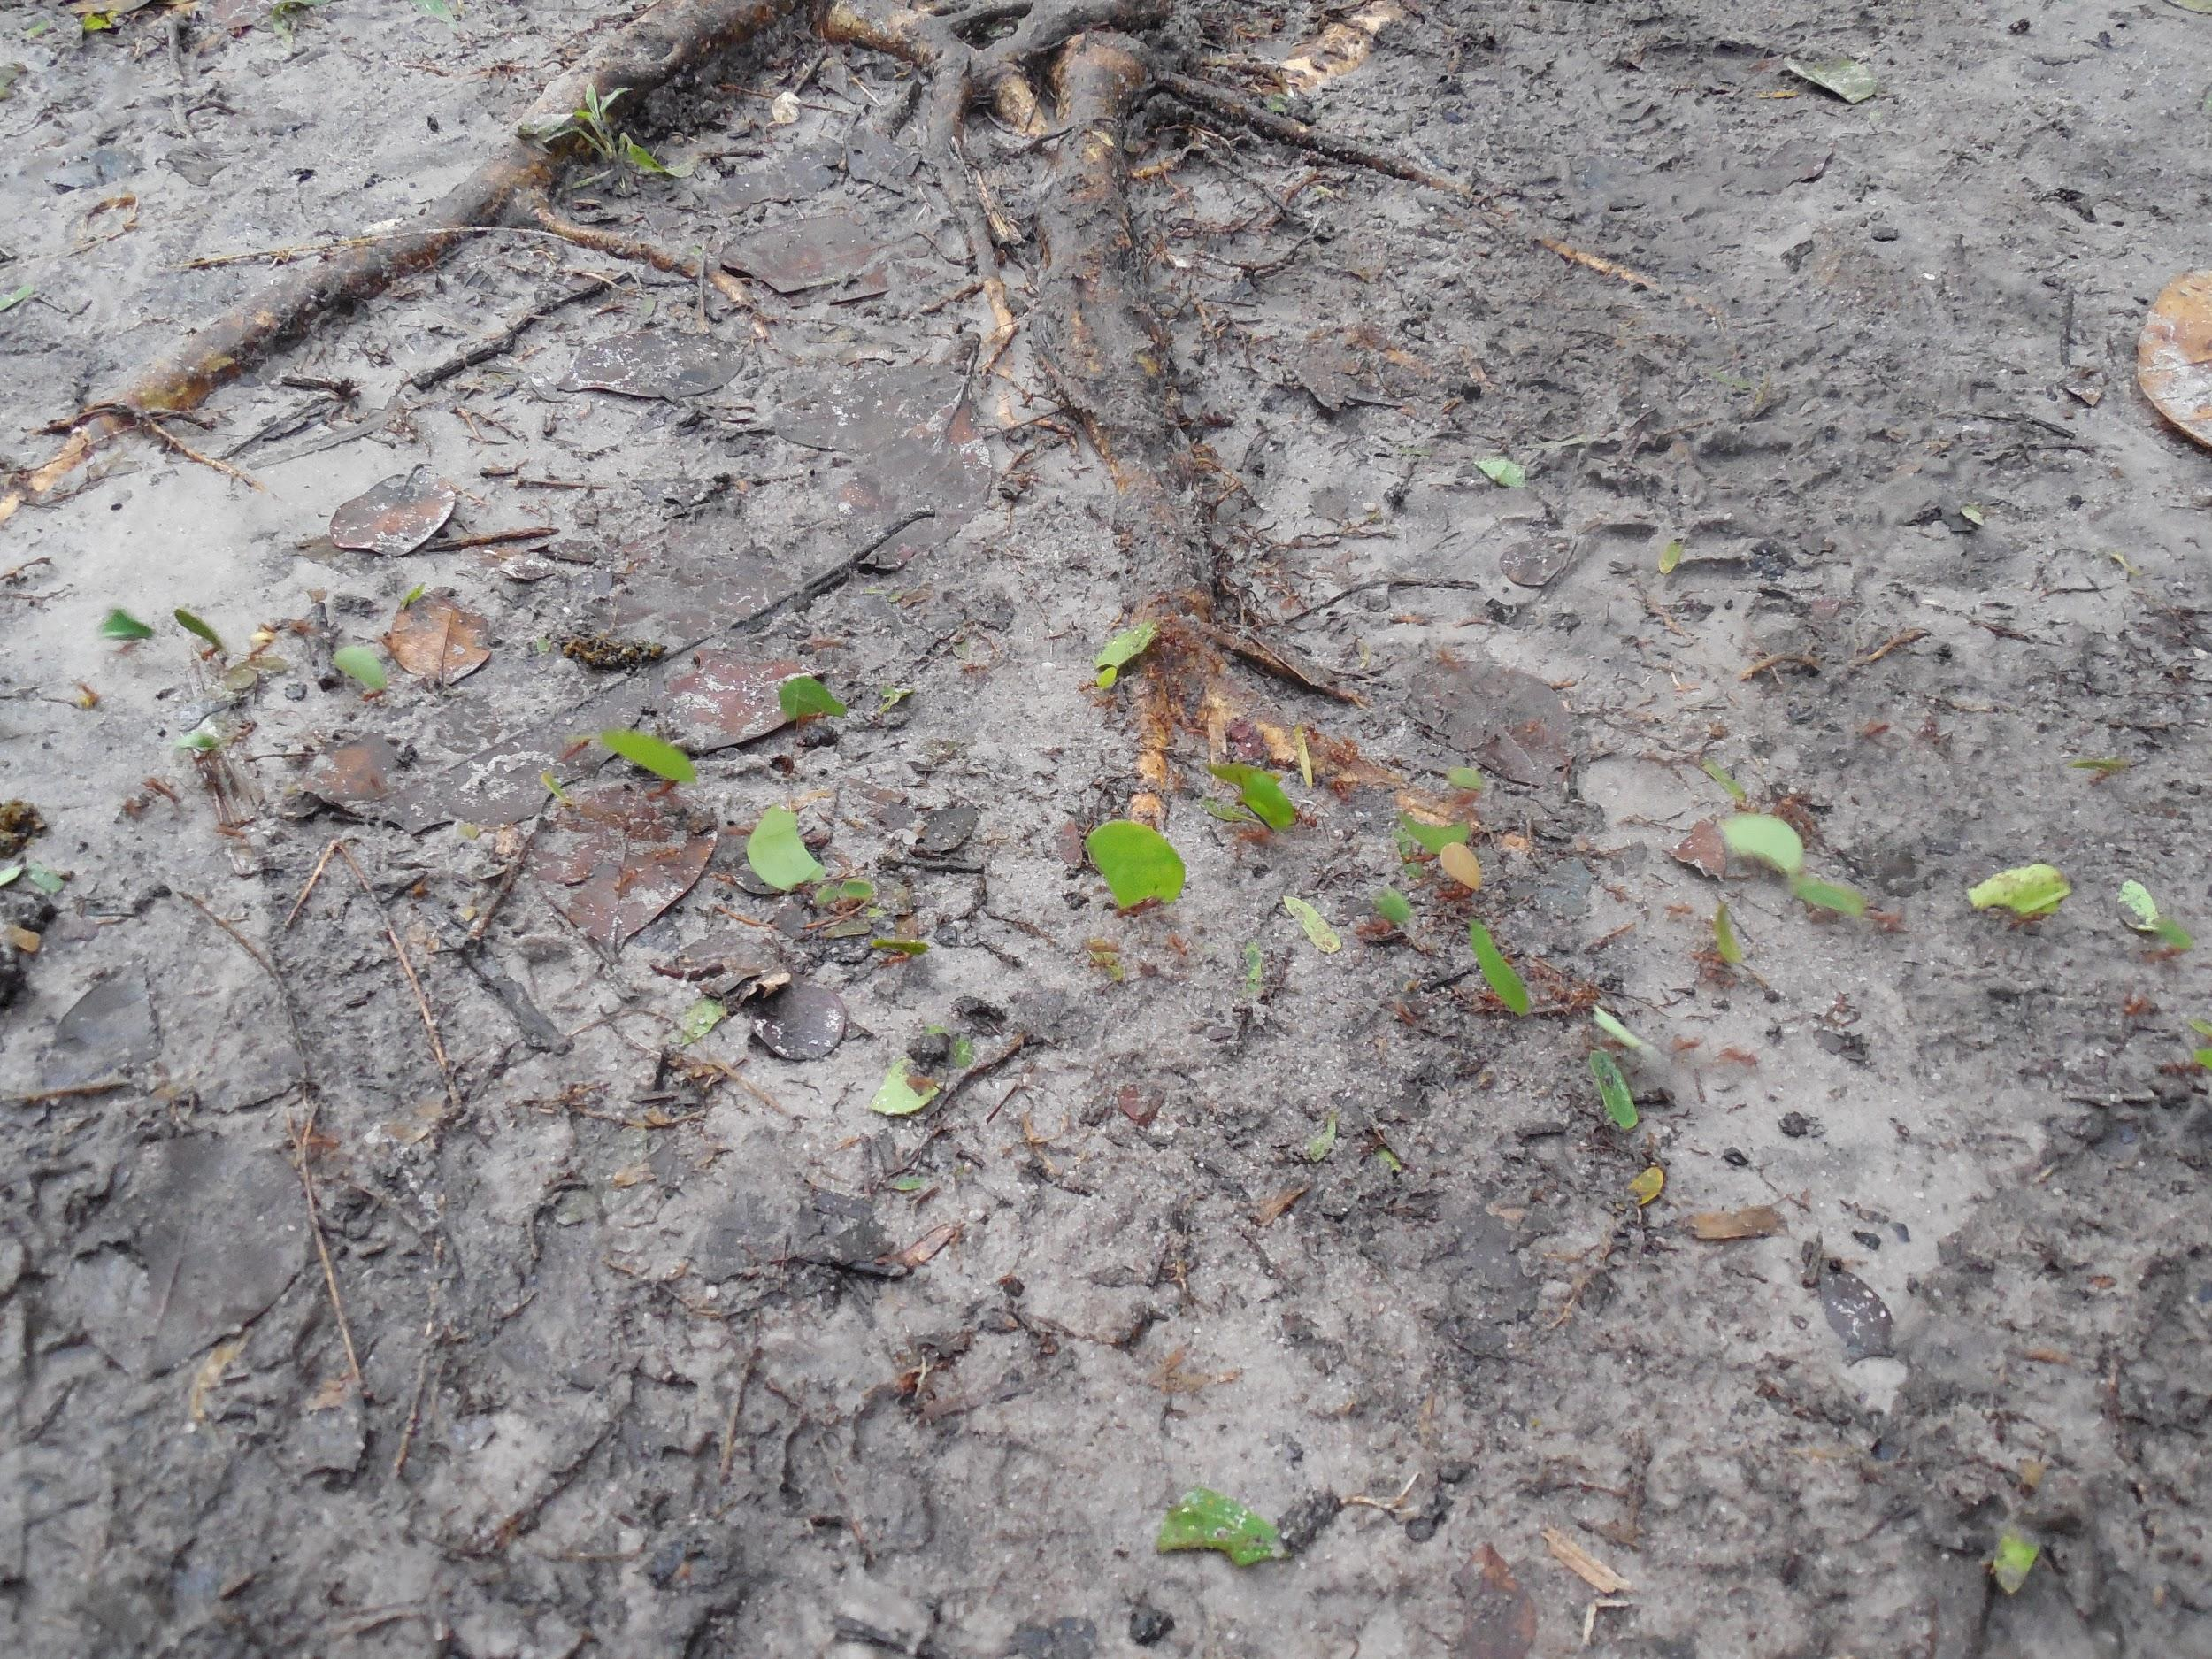
The Baboon Sanctuary
Leaf cutter ants can be used for suturing
Stir up an ant nest to make the soldiers swarm out
Hold them against the skin and they pinch the skin shut
Pull off the bodies, leaving the heads behind

Slide 12
The Belize Zoo
Zoo promoted conservation
Zoo built around the jungle
Habitats with little human influence
Animal rescue
*Took in animals whose parents were killed in the wild or kept as pets
*Animals stayed in zoo entire lives

Slide 13
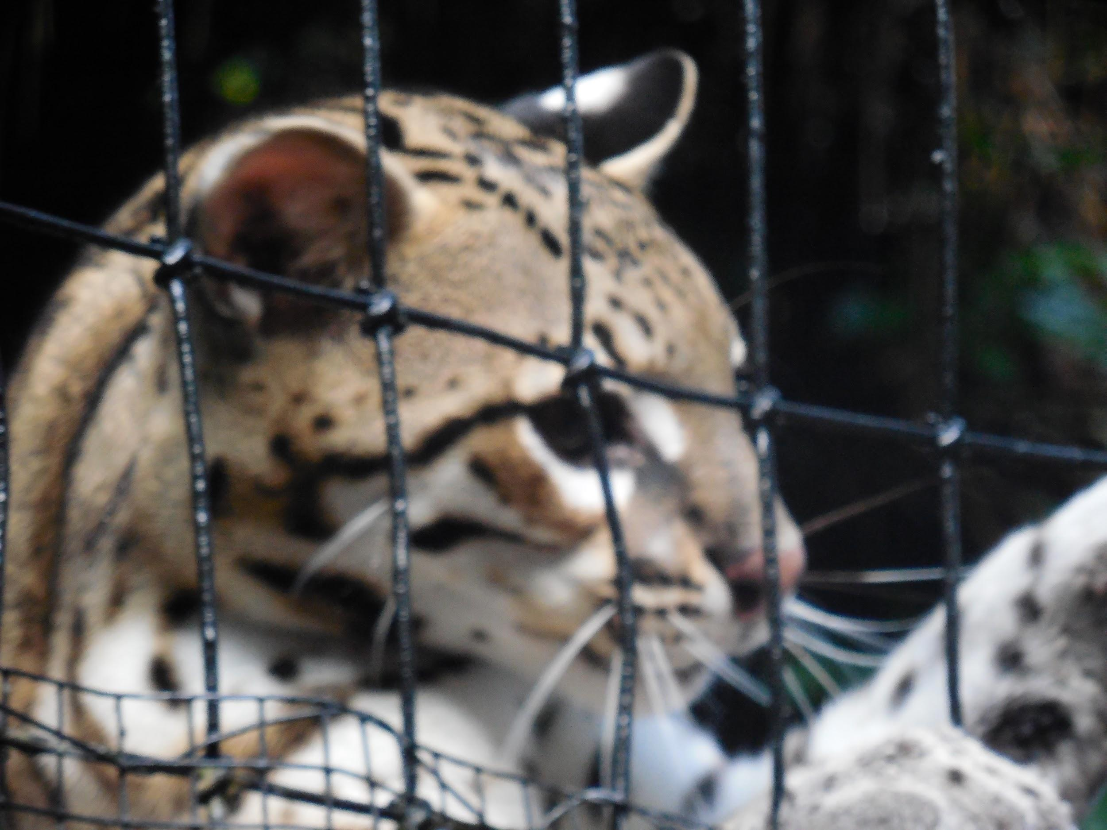
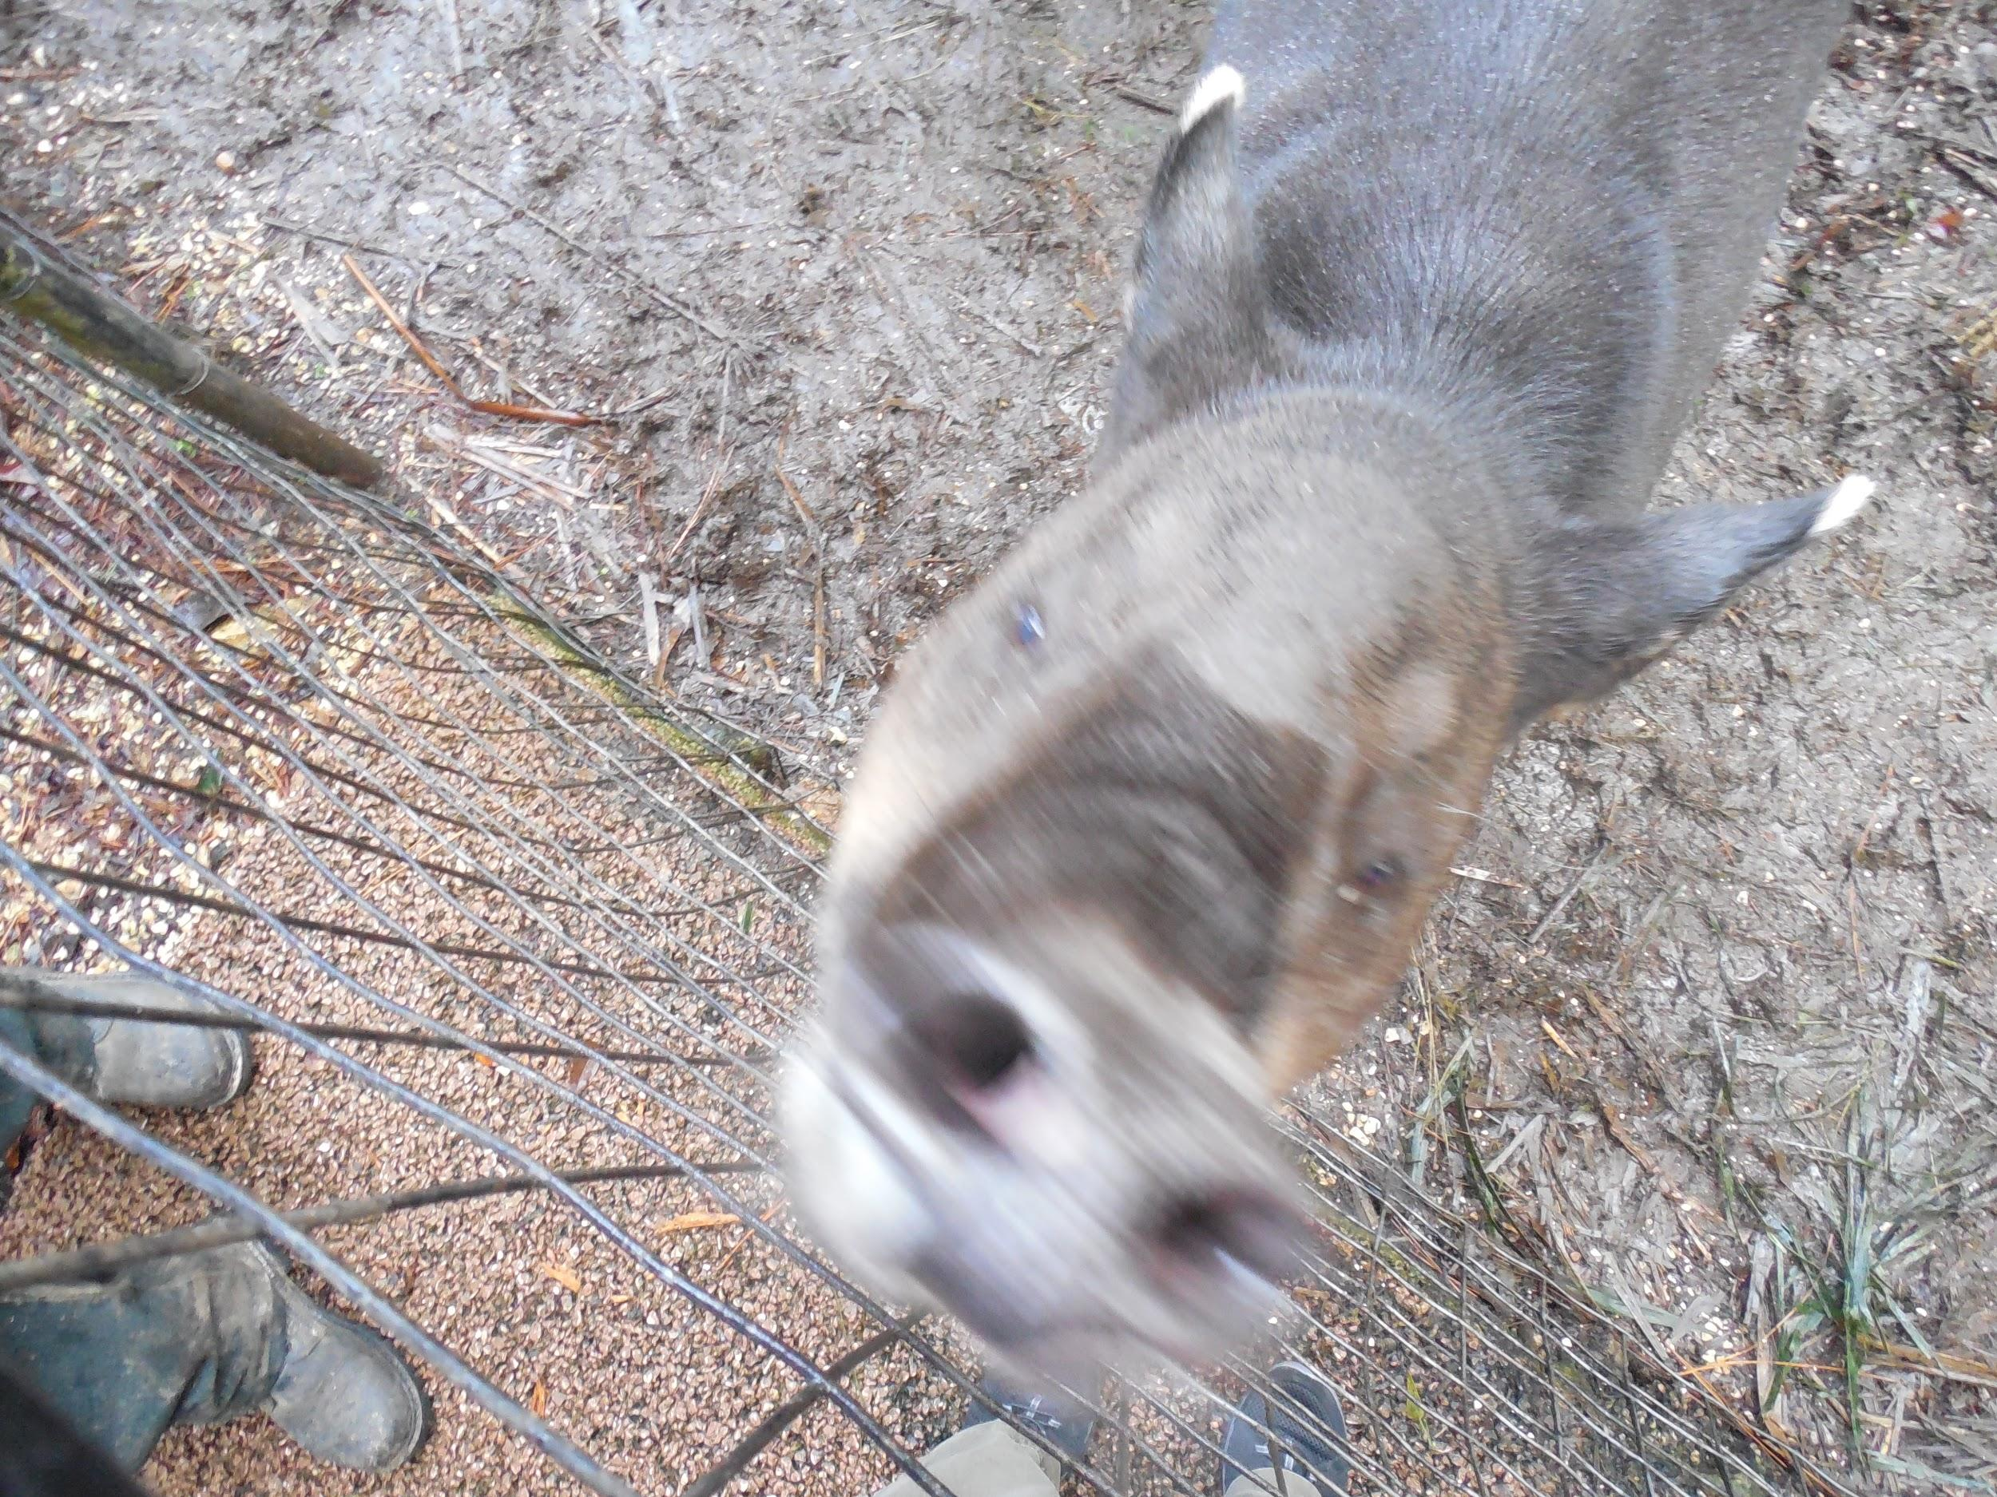
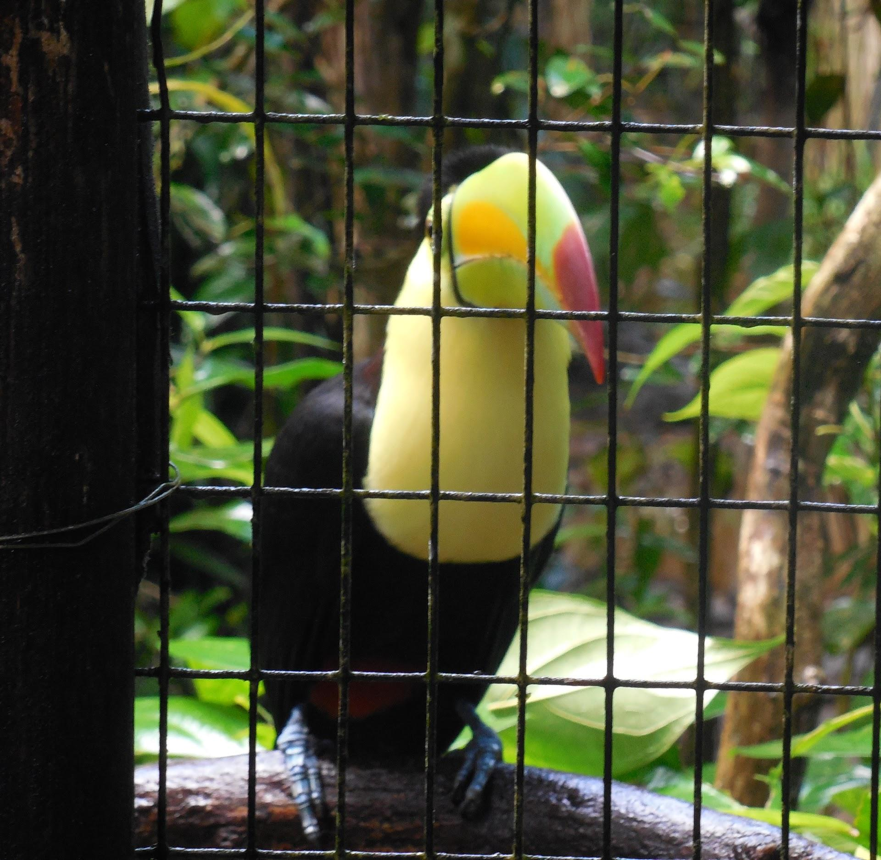
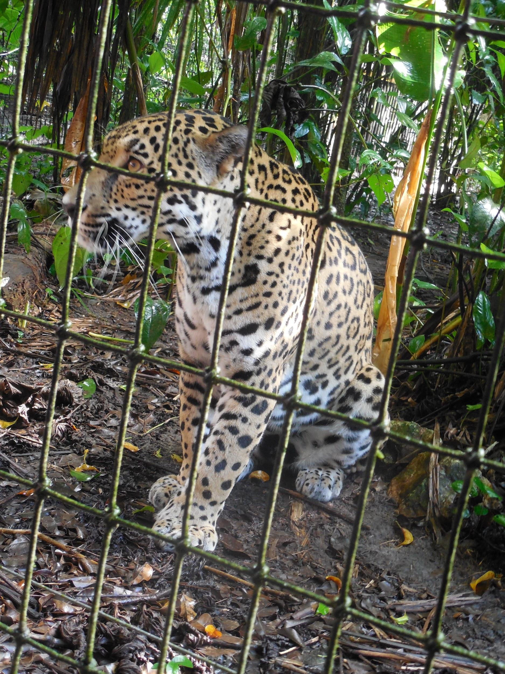
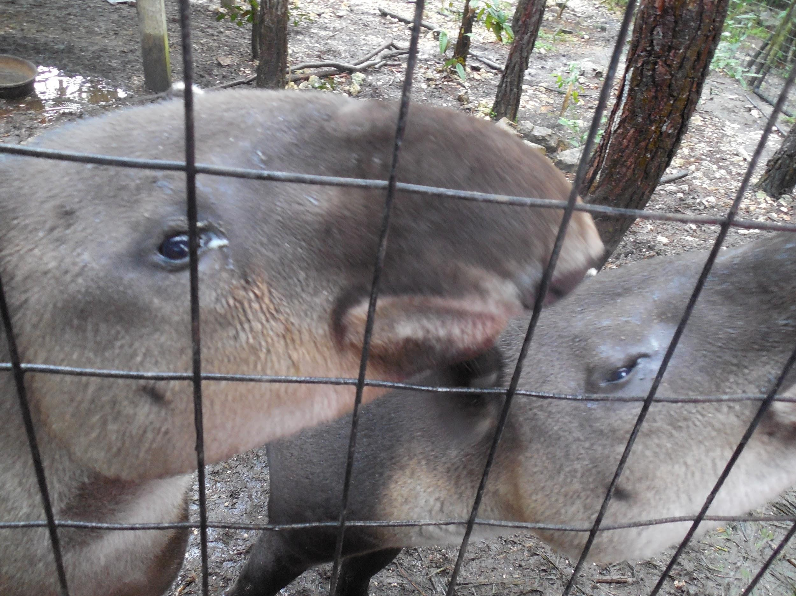
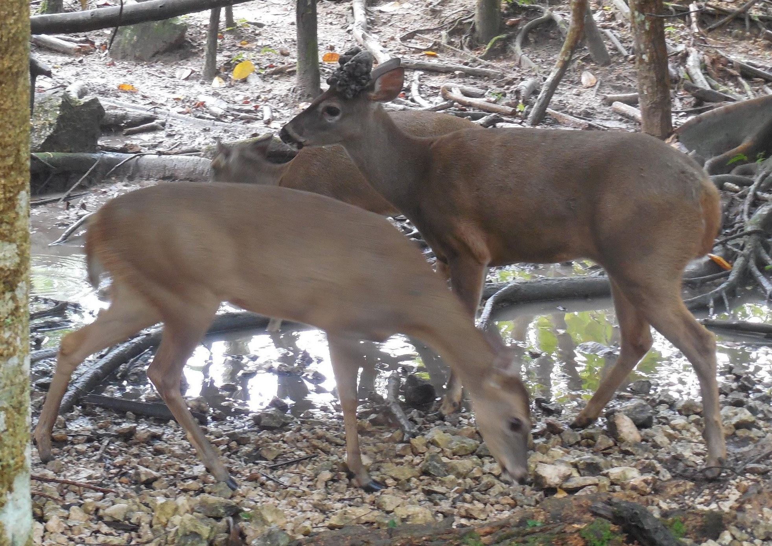
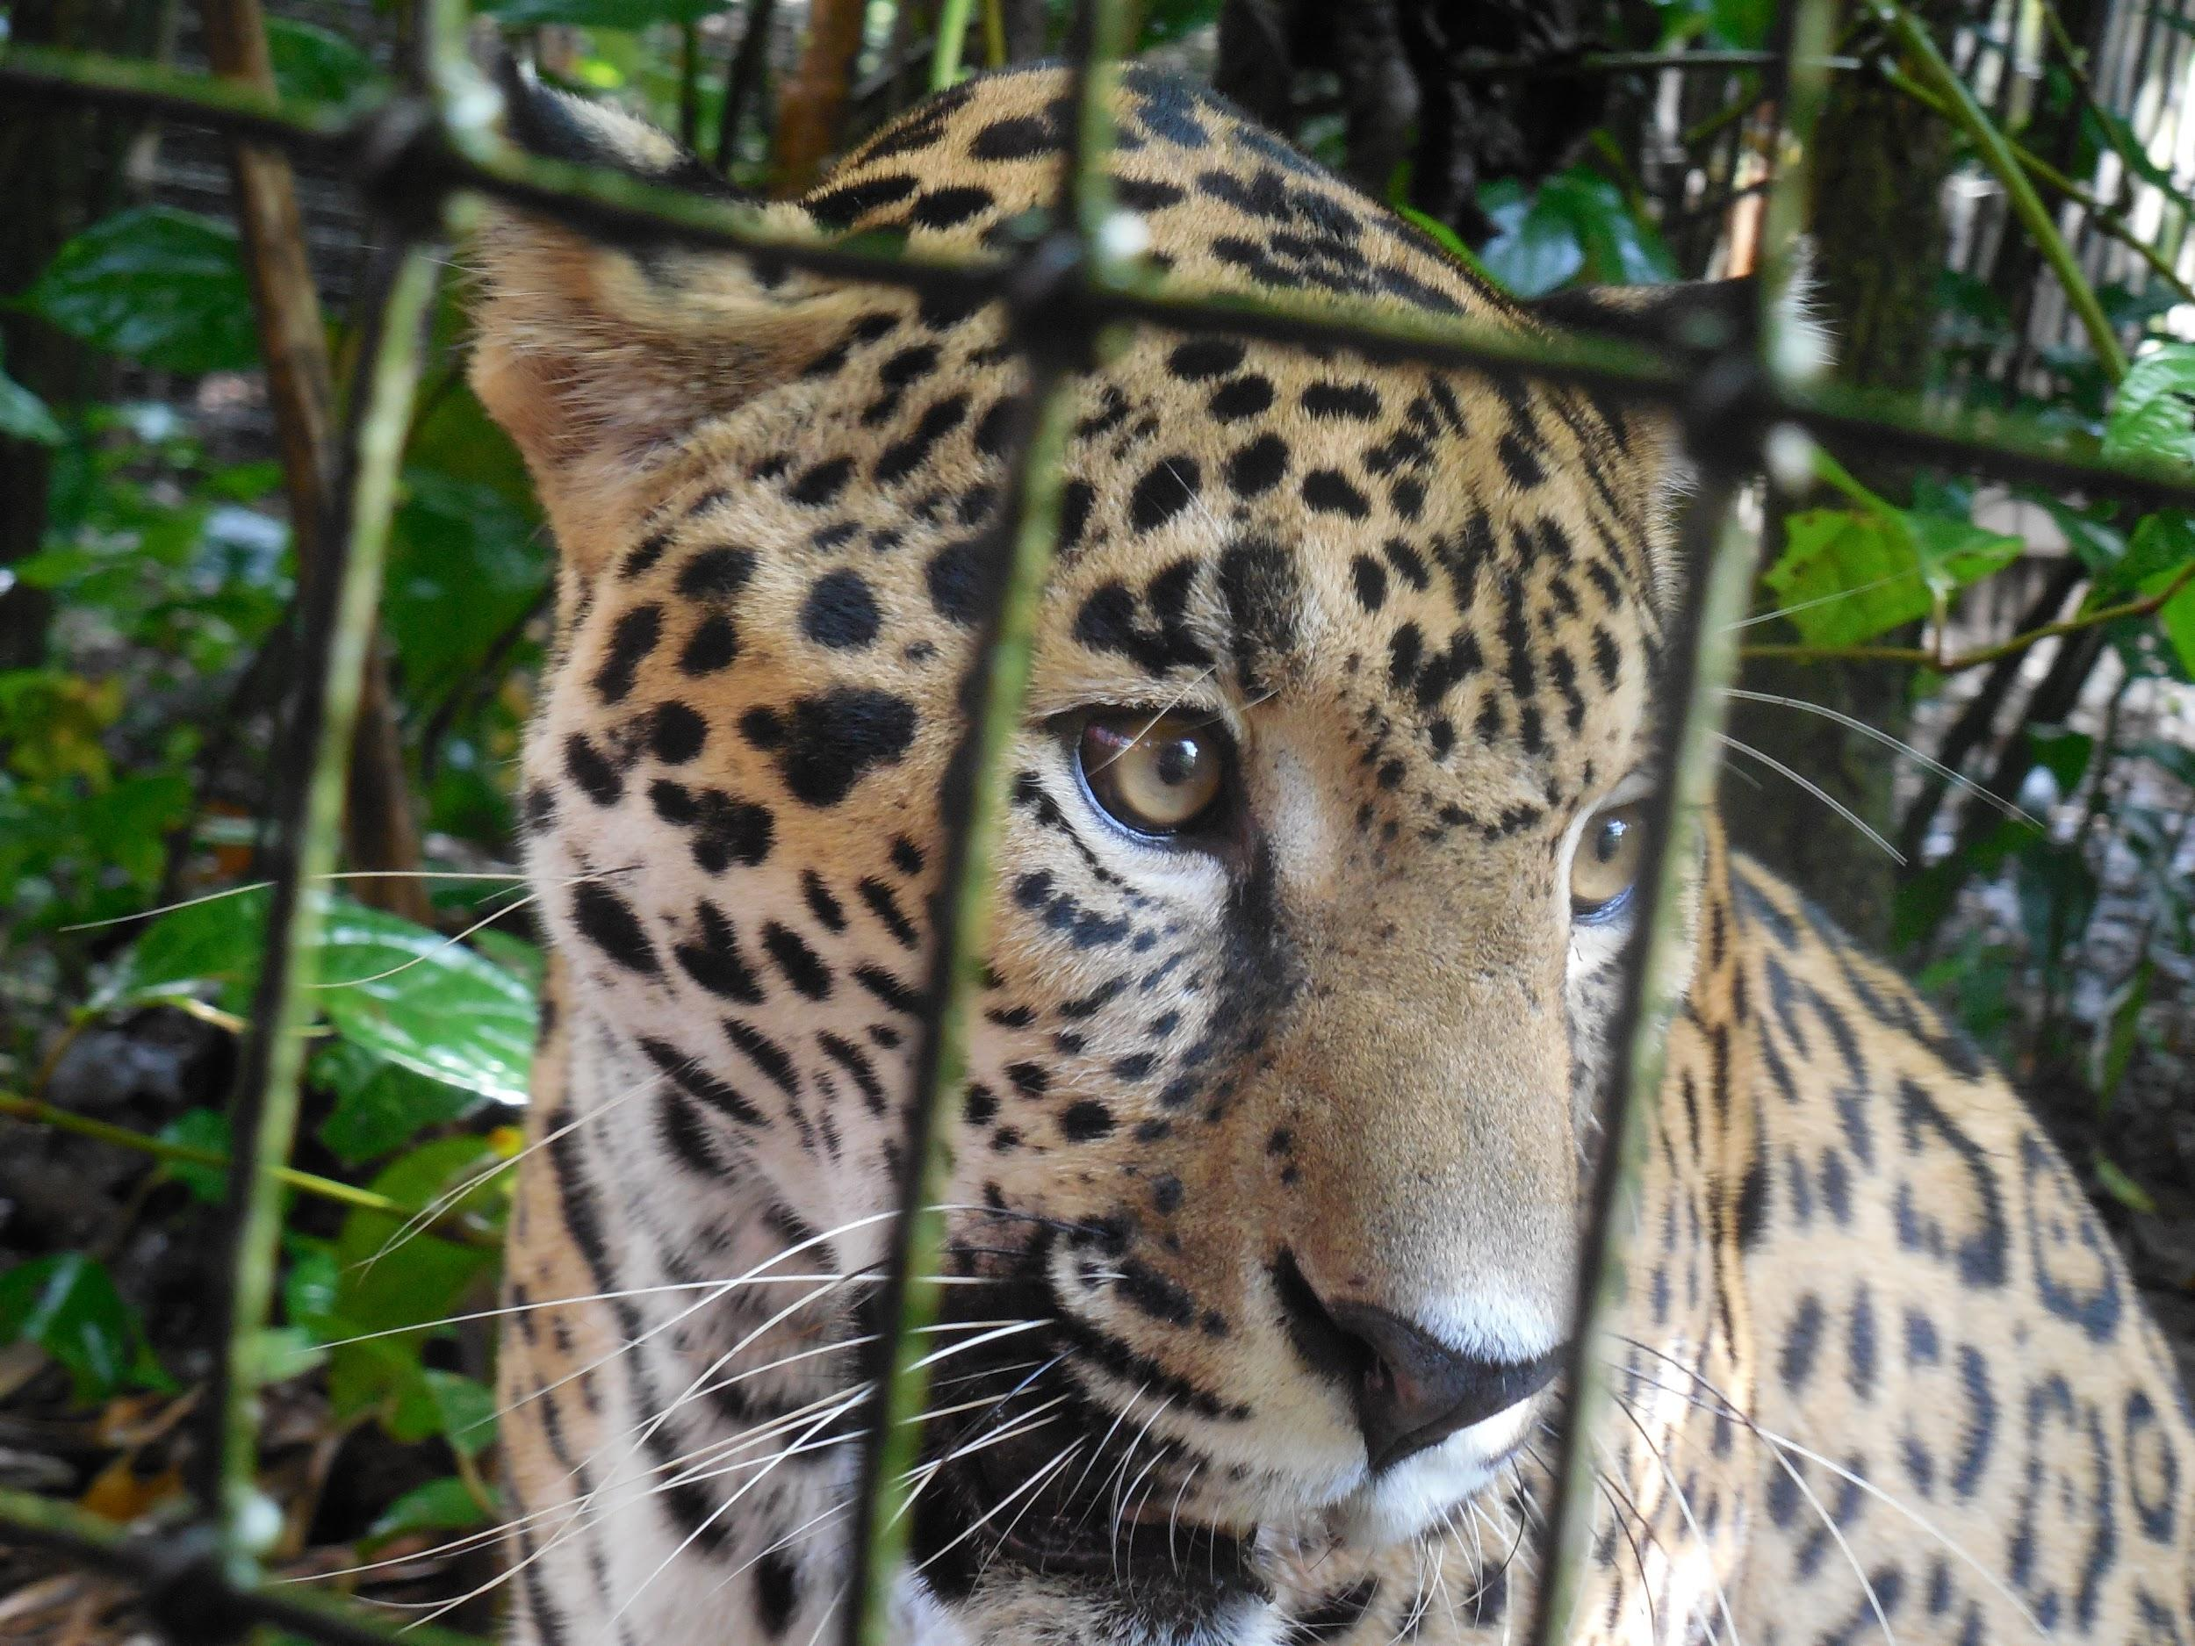
The Belize Zoo

Slide 14
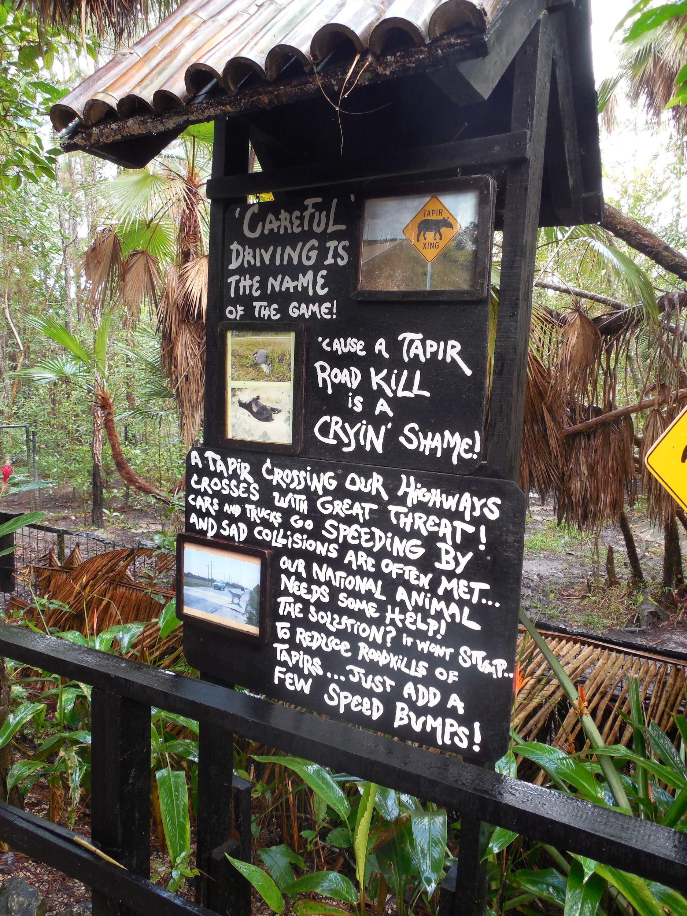
The Belize Zoo
Educated people how to live with wild animals
Tapirs are often hit on roads
Large exhibit of tapirs which included a map of where tapirs cross roads and get hit most often
Emphasized safety and slowing down on roads where tapirs are often hit

Slide 15
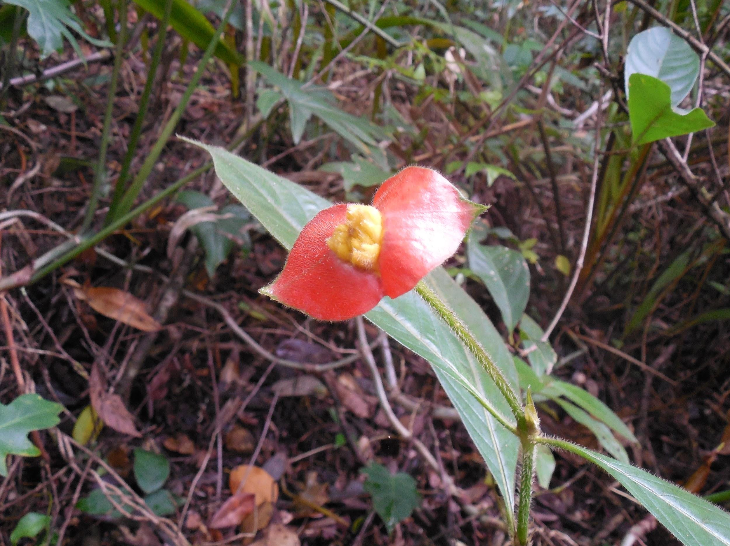
Tropical Education Center
What we learned...
Ethnobotany
*study of how people and plants interact
Plants for medicinal properties
*Hot lips: used to clean out woman’s reproductive tract and help with menstrual issues

Slide 16
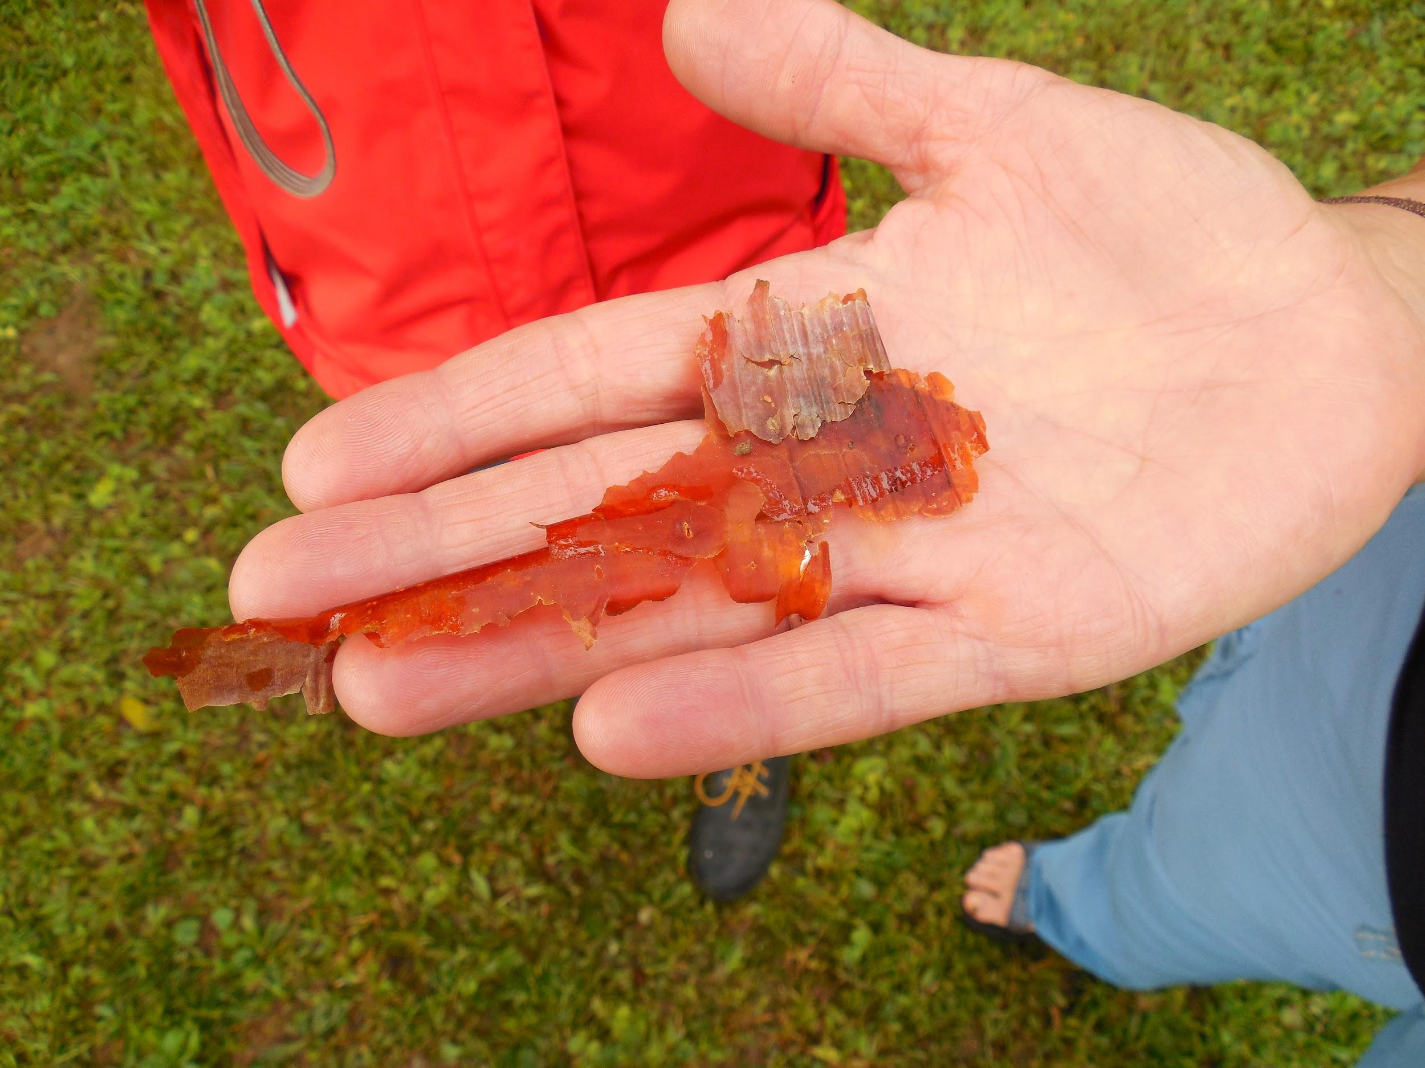
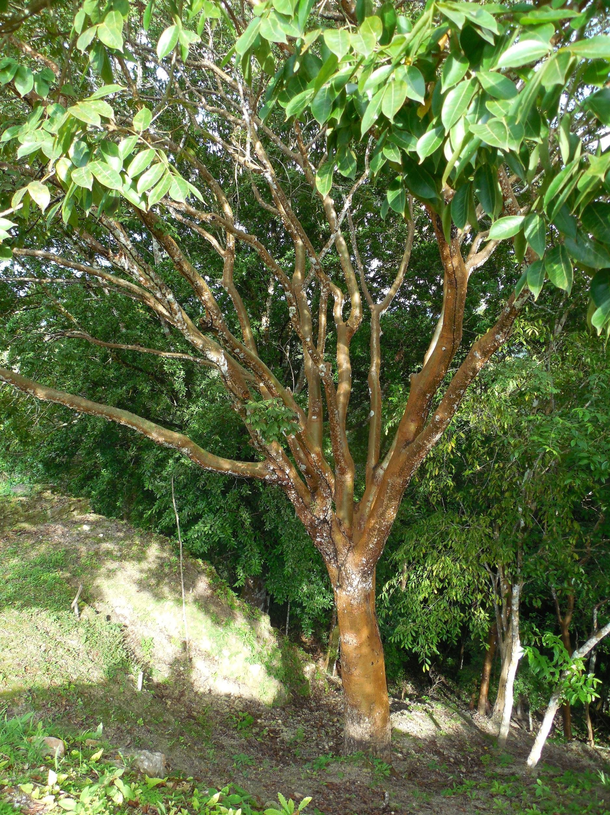
Ethnobotany at the TEC
Gumbo Limbo: Also known as the tourist tree because the bark is red and peels. The bark is rubbed onto the rash from a black poisonwood tree.
Mahogany tree: National tree of belize. Illegal to harvest, though it is harvested illegally.
Gumbo Limbo Bark and Tree

Slide 17
Symbiosis
Mutualism
Relationship between two living organisms where they both benefit
Lichens
*Relationship between fungus and algae: fungus traps water for the algae and the algae performs photosynthesis to feed the fungus

Slide 18
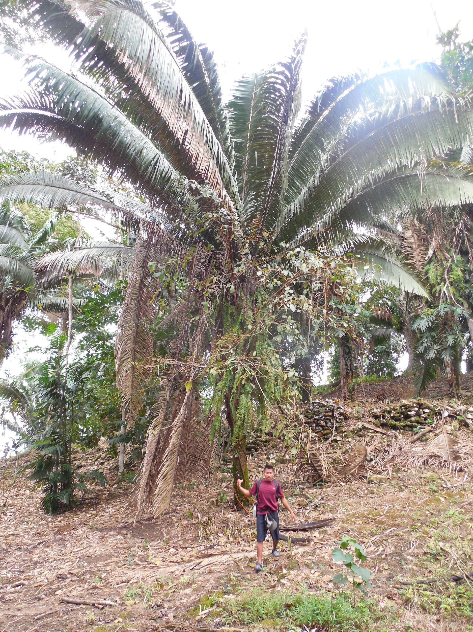
Symbiosis
Parasitism
Relationship with two living organisms where only one benefits
Strangler fig
*Seed drops onto a Cohune palm and sends roots down to the ground. Fig kills the palm, though the fig feeds multiple animals with its fruit

Slide 19
Works Cited
Fermin, G. (2015, January 10). Community Baboon Sanctuary [Personal interview].
Zookeeper. (2015, January 11). The Belize Zoo [Personal interview].
O. (n.d.). Tropical Education Center [Personal interview].
Chub, M. (n.d.). Ethnobotany [Personal interview].
Lessman, Jeannine M., Dr. "Ethnobotany." Personal interview.
Fact Sheets. (2012, September 10). Retrieved January 23, 2015, from http%3A%2F%2Fwww.eeo.ed.ac.uk%2Fsea-belize%2Feducation.html
Gartner, H., & Teul, M. (1998). Fire Ecology. Savanna Nature Trail. Belize: Belize Zoo & Tropical Education Center.
All photo credit goes to Christiana Bredbenner

